Slide 1

Demo week 17
By mitchell van ‘t Kruys – 4058151
Luuk Vogel – 3850560
Viktor Florea – 3880346
David Horvath - 3698009

Slide 2
Table of contents
Description
Changes implemented to the system
Changes implemented to the administrator system
Issues
Priorities
Demo

Slide 3
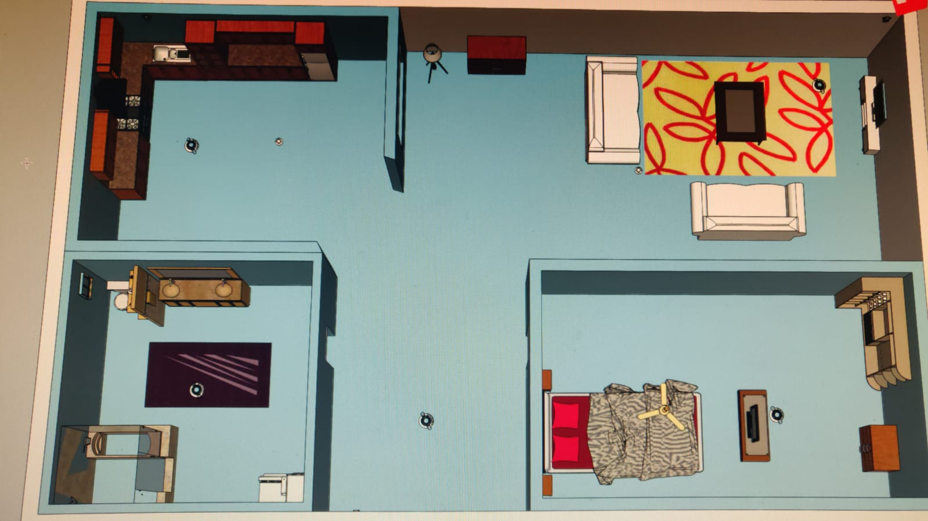
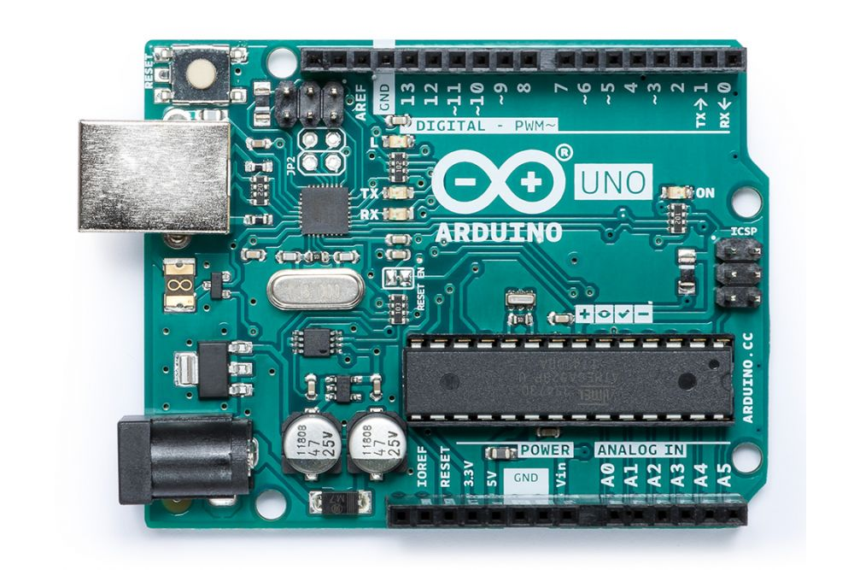
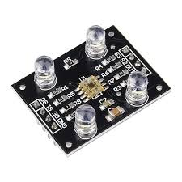

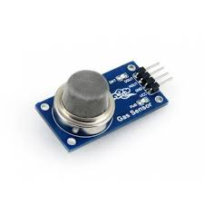
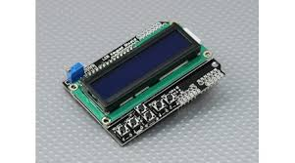
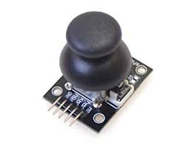

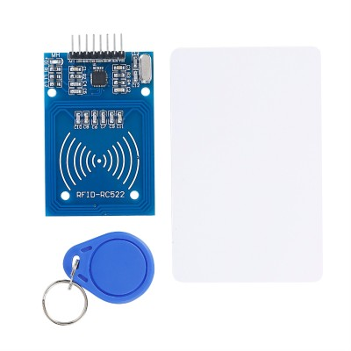
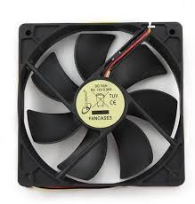

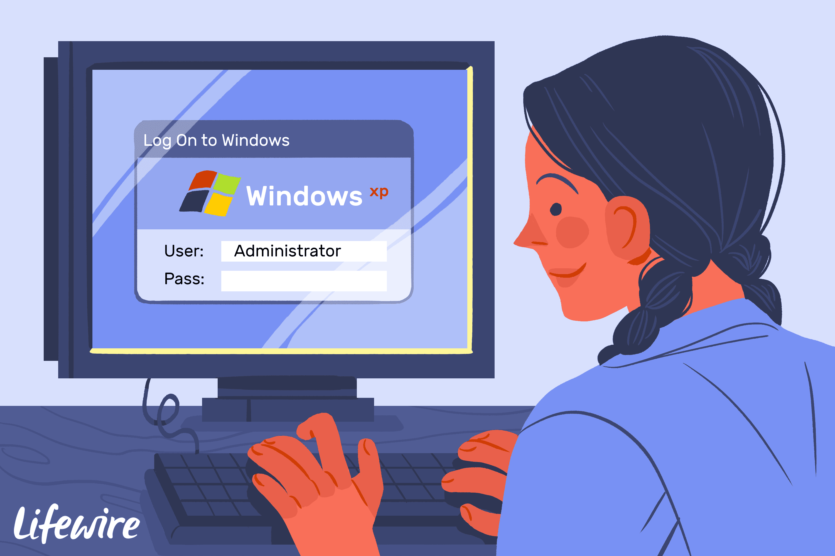
description
How do the Individual systems work?
How they work together.
Communication with the administrator system

Slide 4
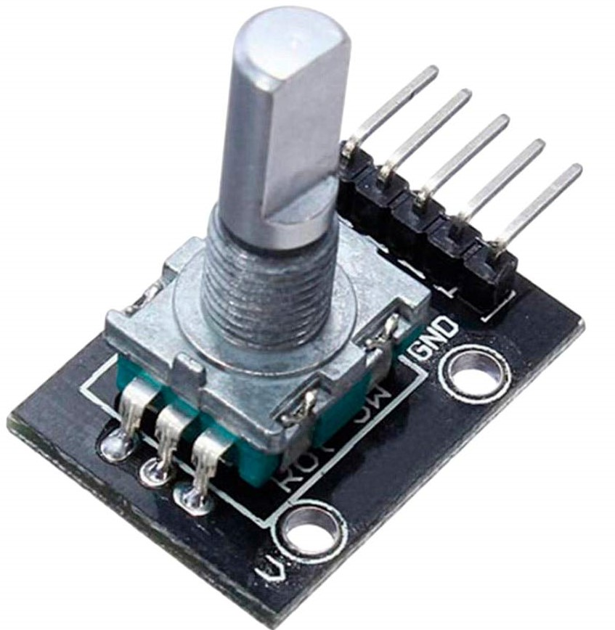
Changes
Door system
Bedroom system
Living room system

Slide 5
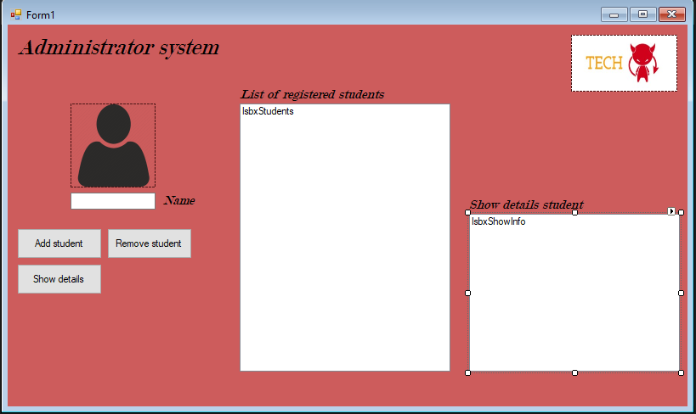
Administrator system

Slide 6
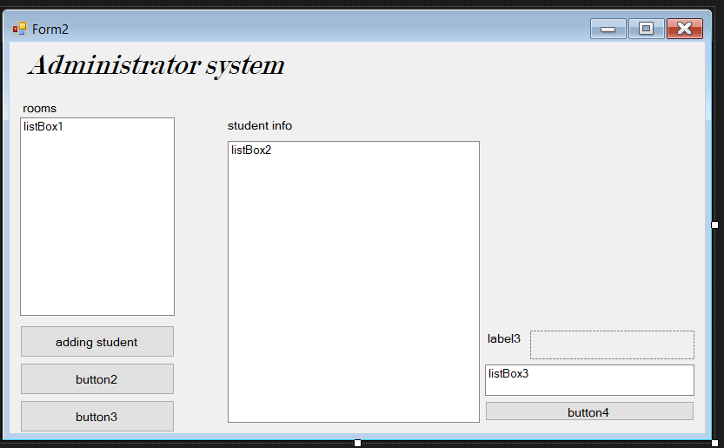
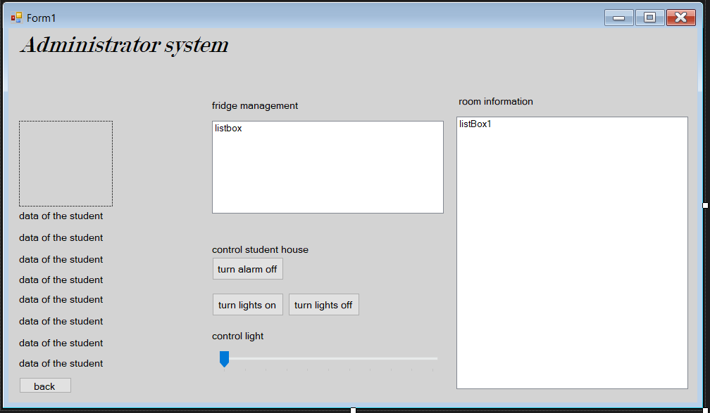
Changes

Slide 7
Issues
Communication between the admin system and the product
Improper timing
Improper baud rate(conversion needed)
Improper code(administration system)
Extra functionality issues
Wifi module
Different baudrates

Slide 8
Priorities
Making the system work together
Finish the fridge system
Proper timing
Finish the administrator system

Slide 9
Demo

Slide 10
Questions?/Feedback

